Slide 1
Presentation “MK Food RESTAURANT Business ANALYSIS”
UROOJ MUZAMMIL
MAAZIN KHALID
23SP-013-BA
23SP-009-BA
PRINCIPLE OF MARKETING

Slide 2
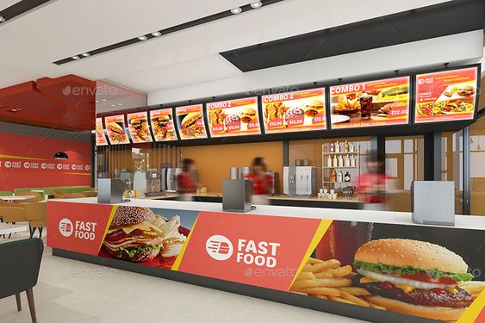
“INTRODUCTION”
“MK Fast Food Restaurant, covering its operations, market conditions, competition, and strategic position. The goal is to pinpoint strengths, weaknesses, opportunities, and threats, offering practical growth recommendations.”

Slide 3
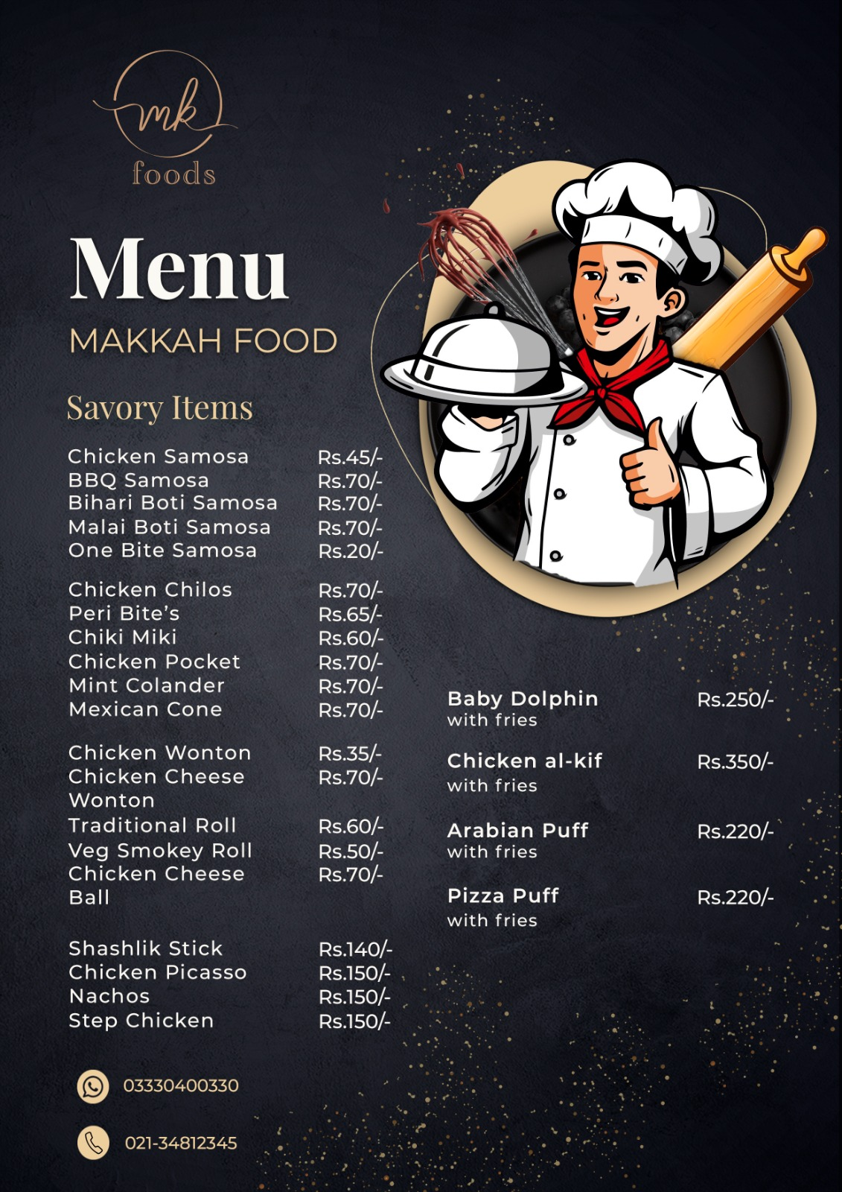
PRODUCT INDUSTRY ANALYSIS:
Industry Overview:
Fast food sector in Karachi is growing due to urbanization, lifestyle changes, and a young population.
Market Size and Growth:
Annual growth rate of 5-7%, increasing fast food demand.
Trends and Drivers:
Health-Conscious Options: Rising demand for healthier choices.
Technology: Online ordering and delivery.
Local Flavors: Menus tailored to local tastes.
Regulatory Environment:
Governed by food safety laws, health inspections, and licensing.

Slide 4
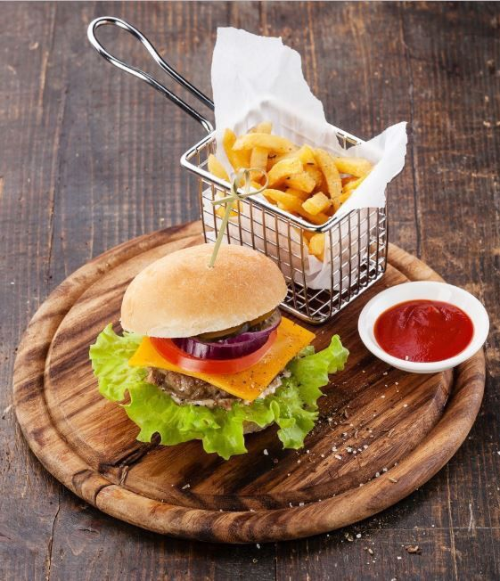
“MARKETING MANAGEMENT ORIENTATION”
Marketing Philosophies:
The key marketing orientations include production, product, selling, marketing, and societal marketing.
Current Orientation:
Focuses on understanding and satisfying customer needs, seen in their diverse menu and customer-first service.

Slide 5


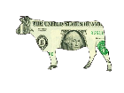
CURRENT BUSINESS PORTFOLIO:
Product Lines:
Burgers: Beef, chicken.
Beverages: Soft drinks, juices, shakes.
Local Specialties: Shawarma, samosas.
Fries and Sides: Regular/spicy fries, onion rings.
Sandwiches: Various options.
Portfolio Analysis:
STAR PRODUCT Baby dolphin with fries Chicken al-kif with fries | QUESTION MARK ? Peri bite’s
CASH COW Burgers Chicken wonton | DOG Chiki Miki
Performance Metrics:
Sales figures, customer reviews, key performance indicators (average order value, retention rate, delivery times).

Slide 6
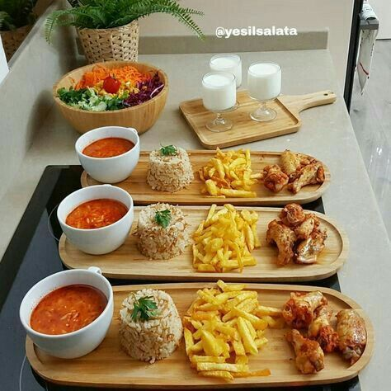
MICRO MARKETING ENVIRONMENT:
Suppliers: Local providers of fresh ingredients.
Intermediaries: Delivery partners like Food Panda and Careem.
Customers: Local residents and office workers.
Competitors: Nearby fast food chains and local eateries.
Publics: Media and community groups.

Slide 7
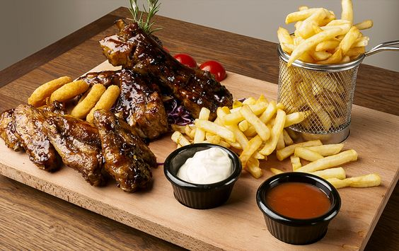
MACRO MARKETING ENVIRONMENT:
Demographic: Young, increasing disposable income.
Economic: Stability and spending patterns.
Natural: Seasonal ingredient availability.
Technological: Online ordering systems.
Political: Food safety policies.
Cultural: Mix of traditional and modern food preferences.

Slide 8
COMPETITIVE MARKET ANALYSIS:
Competitor Identification:
Major Competitors: KFC, McDonald's, and other local fast food joints.
Market Position: Mid-tier option offering quality food at reasonable prices.
Market Position:
Market Share: Competing with major fast food chains.
Strengths and Weaknesses:
Strengths: Local brand recognition, diverse menu.
Weaknesses: Limited marketing budget compared to international chains.
Competitive Strategies:
KFC: Focuses on fried chicken with strong brand loyalty.
McDonald's: Known for its global menu and strong marketing campaigns.
Local Competitors: Emphasize local flavors and affordable pricing.

Slide 9
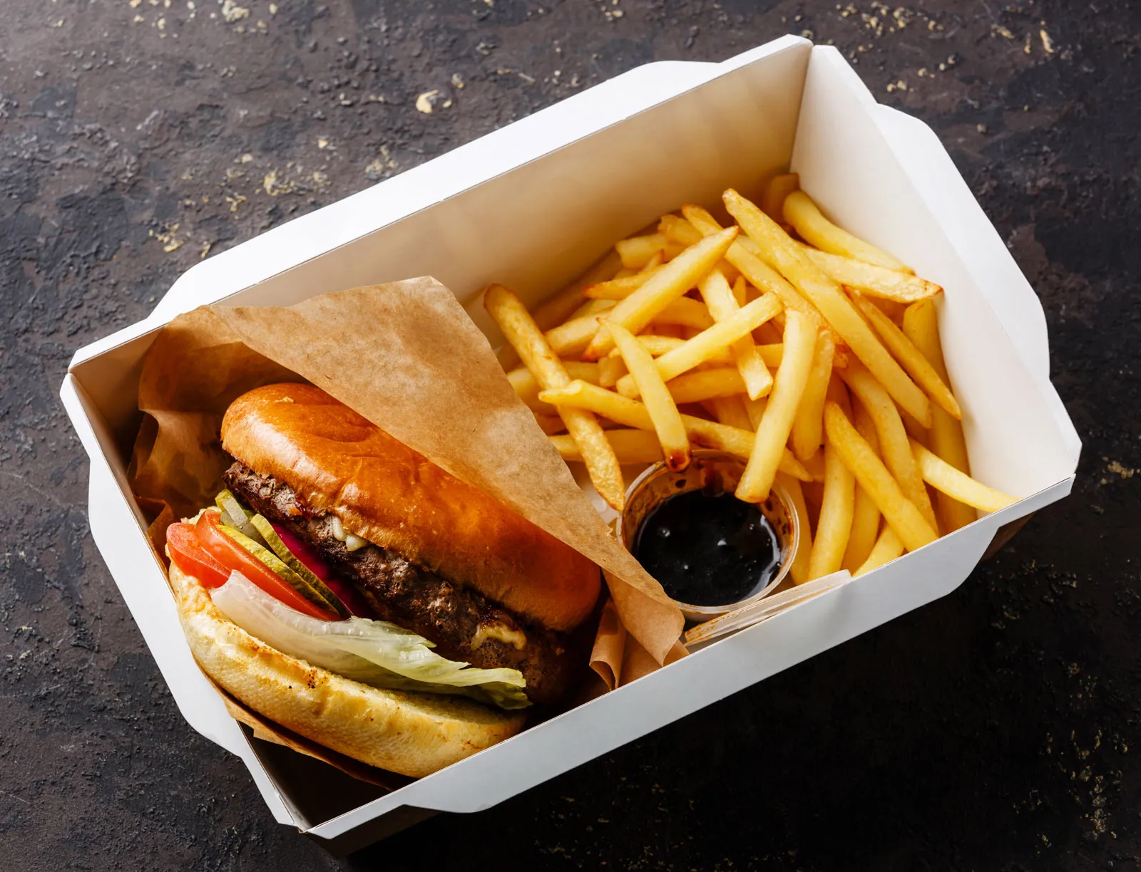
TARGET MARKET & SEGMENTATION:
Target Market:
Primary: Young adults, office workers.
Secondary: Families, teenagers.
SEGMENTATION:
Demographic: Age 15-35, middle to high income.
Geographic: Gulshan-e-Iqbal residents.
Psychographic: Young professionals, students, families.

Slide 10
SWOT ANALYSIS:
Opportunities:
Expansion of online delivery services.
Introduction of healthier menu options.
Partnerships with local businesses for bulk orders.
Threats:
Intense competition from international and local fast food chains.
Economic downturns affecting consumer spending.
Regulatory changes impacting operations.
Strengths:
Strong local brand recognition.
Diverse and affordable menu.
Good customer service and fast delivery.
Weaknesses:
Limited financial resources for large-scale marketing.
Dependence on local suppliers for fresh ingredients.

Slide 11
MARKETING MIX:
Marketing Mix - Product
Product:
High-quality ingredients.
Diverse menu options.
Regular updates based on customer feedback.
Marketing Mix - Place
Place:
Located in a busy area of Gulshan-e-Iqbal with high foot traffic.
Strong presence on online delivery platforms for wider reach.
Marketing Mix - Price
Price:
Competitive pricing strategy.
Occasional discounts and promotions to attract customers.
Marketing Mix - Promotion
Promotion:
Social media marketing to engage with customers.
Local advertising through flyers and community events.
Special promotions and discounts during festivals and holidays.
Customer loyalty programs and referral incentives.

Slide 12
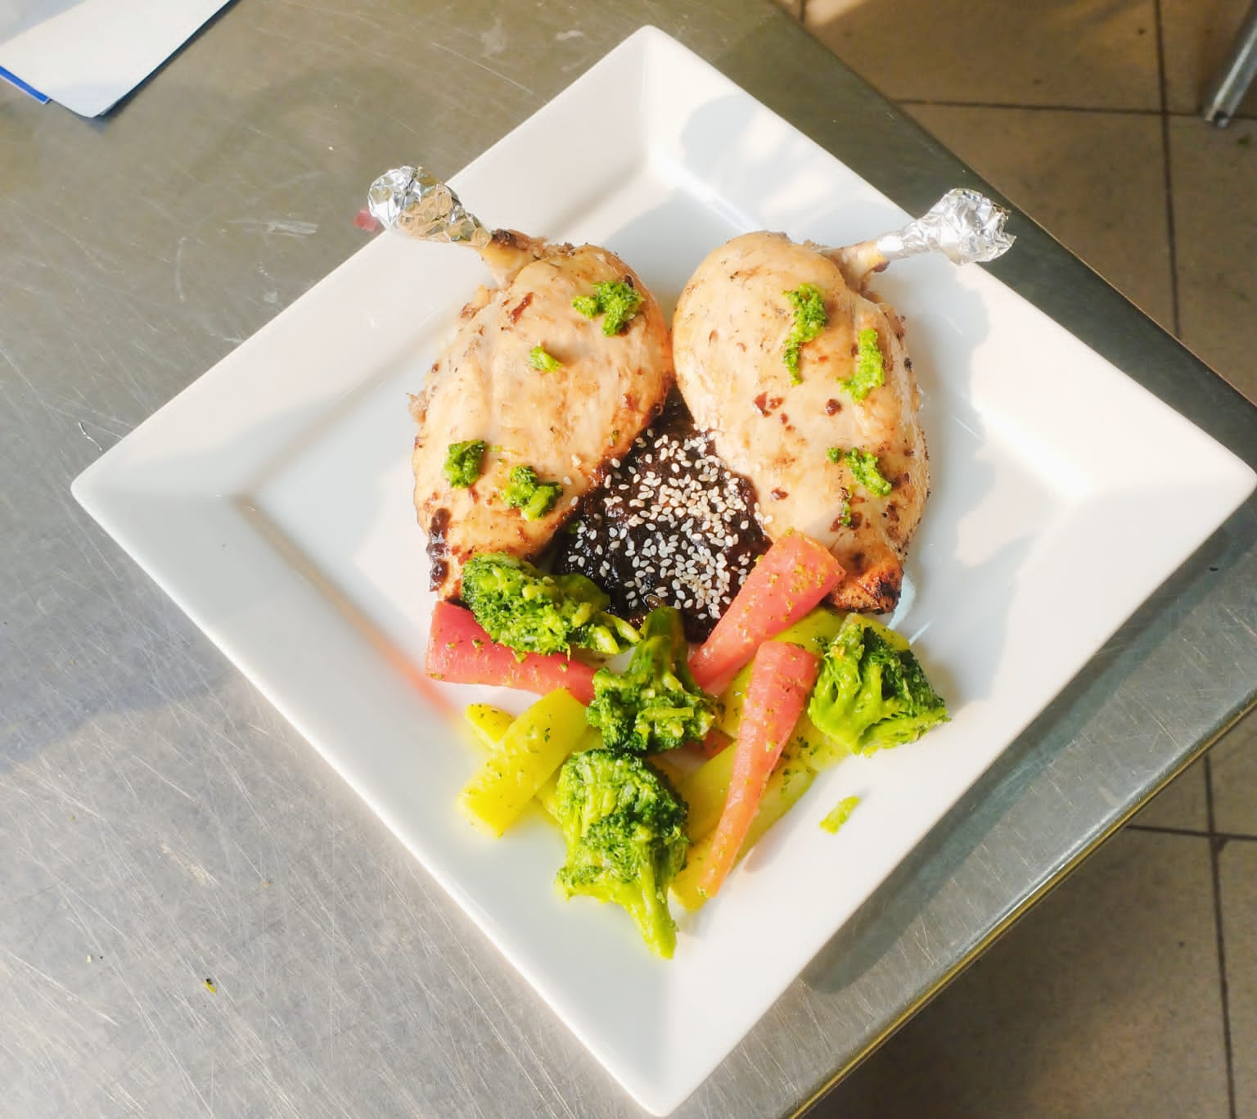
CONCLUSION:
“MK Food Restaurant has established itself as a popular local fast food destination in Karachi. With a strong focus on customer satisfaction, quality, and affordability, the restaurant has carved out a significant market niche.”

Slide 13

INTERVIEW

Slide 14


THANK YOU

